Slide 1
UMBC TEXTBOOK MARKETPLACE
(THE A-TEAM) D4
TUC NGUYEN - AMRA MO - JUN KWON - HAO WU
AMIR BESHIR - SOPHIA SHIN

Slide 2
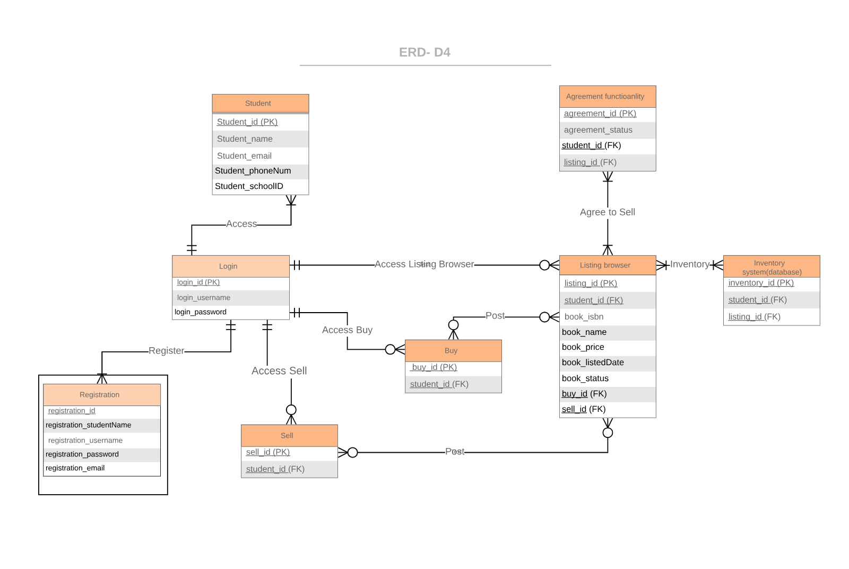
ENTITY-RELATIONSHIP DIAGRAM

Slide 3
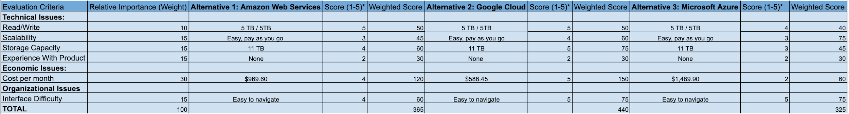
ALTERNATIVE MATRIX

Slide 4
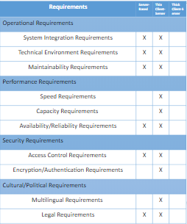
ARCHITECTURAL DESIGN

Slide 5
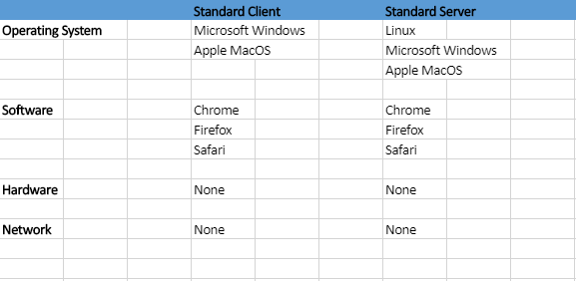
HARDWARE AND SOFTWARE SPECIFICATION
Remote Google Cloud Server
Remote Google Cloud Server
Internet
Internet

Slide 6
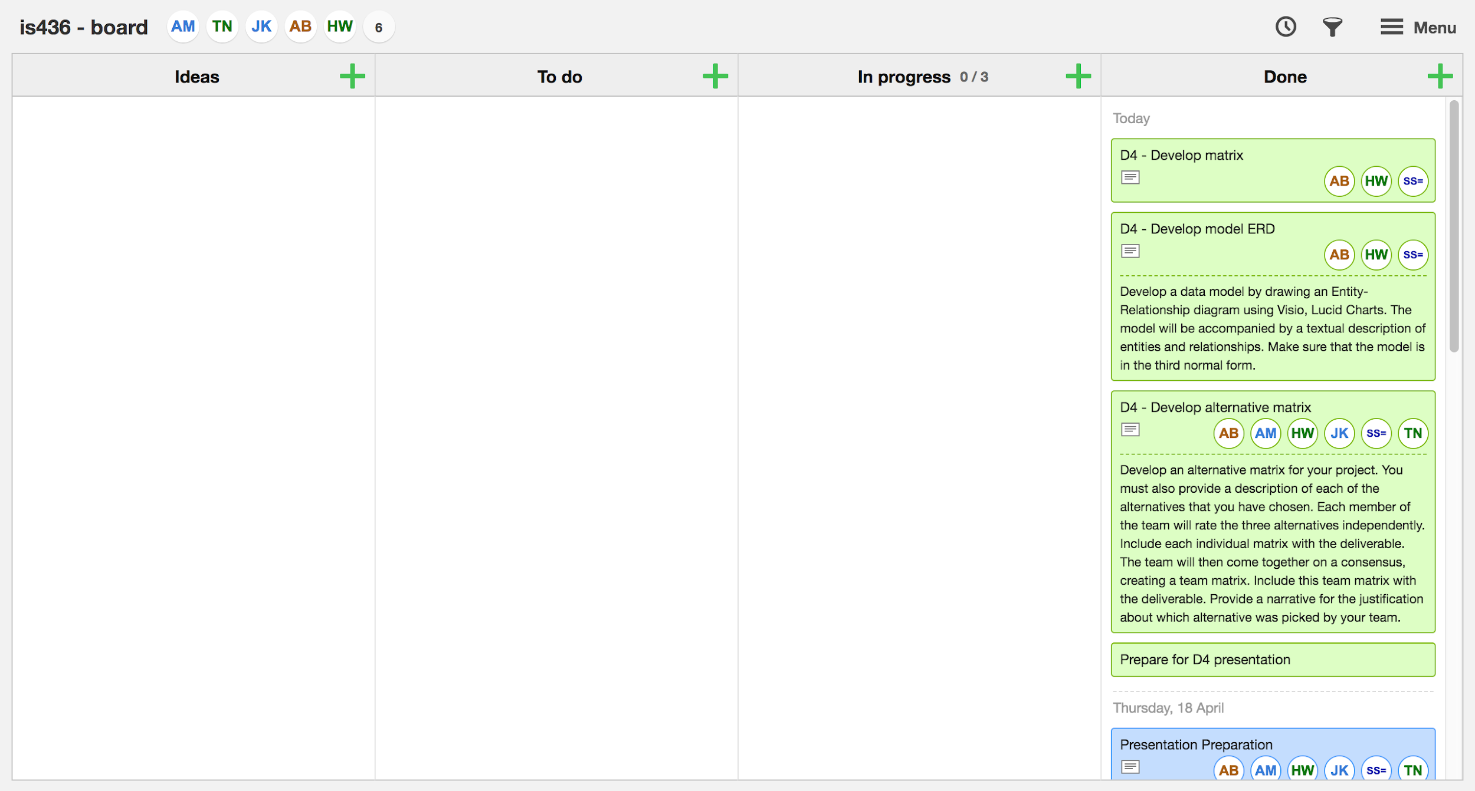

Slide 7
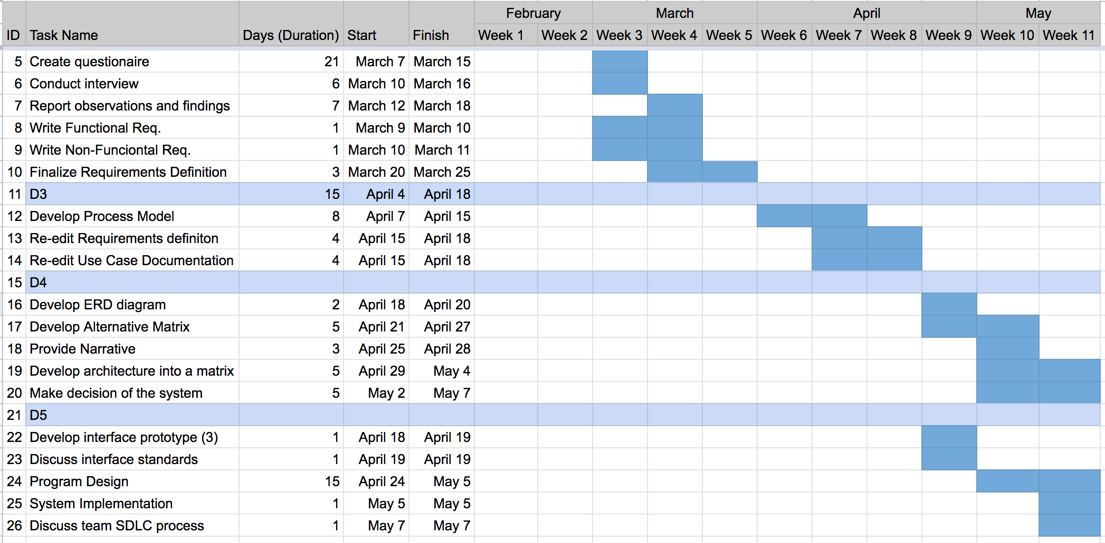

Slide 8
QUESTIONS?

